Slide 1


Why disabled and neurodivergent people are not engaging in your user research (and how to change that!)
Thursday 9th June 2022, from 13:30 -15:00
By Lynn Pilkington & Morgane Tanguy
© This is Milk 2022

Slide 2
Welcome
© This is Milk 2022

Slide 3
Workshop Objectives
What we will cover
Identify barriers for disabled and neurodivergent participation in digital services and user research.
Design more inclusive virtual events and workshops.
Be aware of inclusive terminology.
Apply learning from the session, including engaging with other participants.
© This is Milk 2022

Slide 4
Netiquette
Feel free to eat or not.
You do you, get involved where/when/how you can, going to be a participatory session but rest your eyes/stretch/pee.
Share your thoughts/feelings/ideas and monitor the airspace that this takes.
Personal sharing is for honouring.
Stay muted, use chat function, unmute/thumbs up/hands up to contribute.
Try our best to speak one at a time.
Questions
© This is Milk 2022

Slide 5
Neurodiversity recognises the cognitive difference in brains and that some peoples’ brains function in a different way to others.
It challenges the notion that there is just one way for a brain to operate and raises awareness of the fact that there are many positives in having diversity of functioning.
© This is Milk 2022

Slide 6
Key Things to Know
Neurodiverse people experience, interact with, communicate and interpret the world in unique ways.
Umbrella term: autism, ADHD, learning disabilities, and more.
Up to 40% of the population may be considered neurodivergent.
© This is Milk 2022

Slide 7
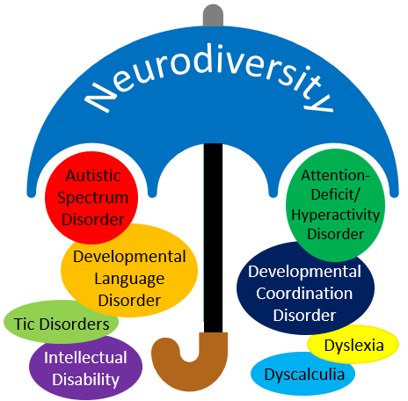
Neurodiversity umbrella.
© This is Milk 2022

Slide 8
Legal disability
The definition is set out in section 6 of the Equality Act 2010. It says you’re disabled if:
you have a physical or mental impairment
that impairment has a substantial and long-term adverse effect on your ability to carry out normal day-to-day activities.
Definition
© This is Milk 2022

Slide 9
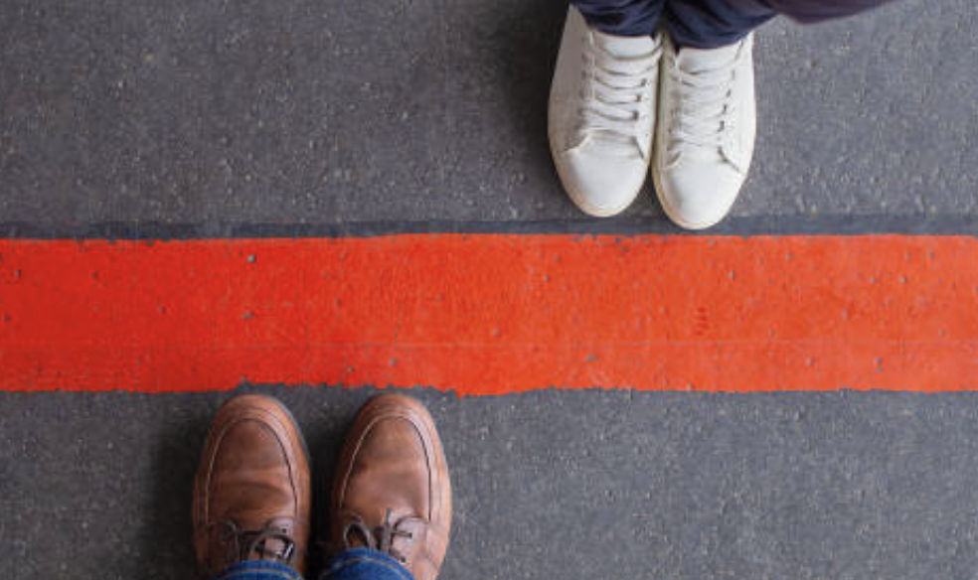
Keep in Mind
Disabled people may not know they are ‘disabled’ under law.
Disability ‘looks like’ all of us.
Diagnosis is a complex area.
Language of ‘impairment’ can be problematic.
Everyone is different and their experiences will be unique to them.
© This is Milk 2022

Slide 10
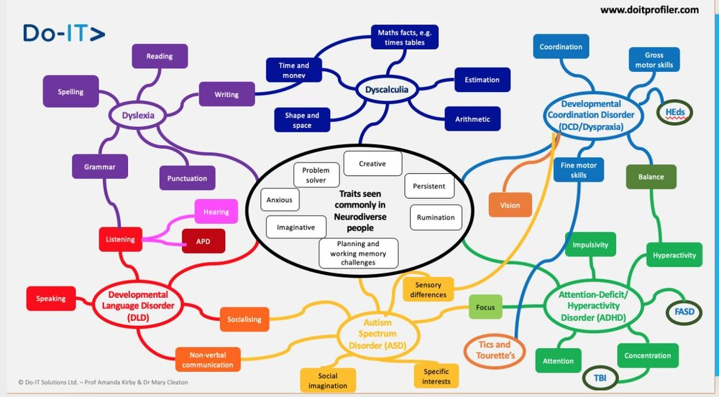
© This is Milk 2022

Slide 11
Everyone has a right to access our digital services and benefit from participation in society. No one should be excluded, whether unintentionally or not.
© This is Milk 2022
Notes:
I don’t have issues with verbal dyspraxia for example,

Slide 12
You are wanting to conduct online interviews with disabled users. 4 break out rooms with 4 scenarios. 15min to discuss scenarios.
Activity
© This is Milk 2022
Notes:
Divider slide - Green
Copyright footer: © This is Milk 2020
Divider – Text – Yellow
Date format: 9-Jun-22
Font / Weight: Futura LT Book - Regular
Title font size: 32pt
Left Aligned

Slide 13
Activity
Room 1 – scenario: Anna: Young, educated, sharp, and blind from birth.
Room 2 – scenario: Bill: Poor vision, red-green color blind, aging.
Room 3 – scenario: Charlie: Middle-aged, working professional in a wheelchair with fine motor skill disabilities.
Room 4 – scenario: Ezra: Middle-aged person with ADHD and dyslexia, working part time.
© This is Milk 2022
Notes:
Divider slide - Green
Copyright footer: © This is Milk 2020
Divider – Text – Yellow
Date format: 9-Jun-22
Font / Weight: Futura LT Book - Regular
Title font size: 32pt
Left Aligned

Slide 14
Activity
Answer the following:
How would you find out about their challenges and barriers?
What adaptations could you do to help them engage in the user research process?
Do you have any good practices to share with others?
How do you speak to them about their challenges?
© This is Milk 2022
Notes:
Divider slide - Green
Copyright footer: © This is Milk 2020
Divider – Text – Yellow
Date format: 9-Jun-22
Font / Weight: Futura LT Book - Regular
Title font size: 32pt
Left Aligned

Slide 15
Activity
How would you find out about their challenges and barriers?
Use personas. Understanding disabilities and impairments: user profiles - GOV.UK (www.gov.uk)
Use accessibility guidelines.
Use disability simulator. Funkify – A disability simulator for the web
Get feedback from disabled staff/staff networks.
Try out assistive technology.
Speal to them! - ask about access needs in advance.
© This is Milk 2022
Notes:
Divider slide - Green
Copyright footer: © This is Milk 2020
Divider – Text – Yellow
Date format: 9-Jun-22
Font / Weight: Futura LT Book - Regular
Title font size: 32pt
Left Aligned

Slide 16
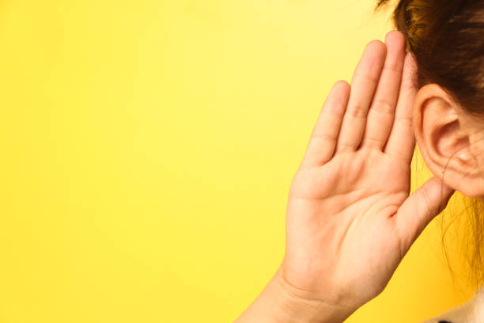
The Barriers and Challenges
© This is Milk 2022
Notes:
Divider slide - Green
Copyright footer: © This is Milk 2020
Divider – Text – Yellow
Date format: 9-Jun-22
Font / Weight: Futura LT Book - Regular
Title font size: 32pt
Left Aligned

Slide 17
Auditory Disabilities
Range from mild or moderate hearing loss in one or both ears (“hard of hearing”) to substantial and uncorrectable hearing loss in both ears (“deafness”).
Definition

Slide 18
Auditory Disabilities
Examples barriers
Audio content, such as videos with voices and sounds, without captions or transcripts.
Media players that do not display captions and that do not provide volume controls..
Web-based services, including web applications, that rely on interaction using voice only.
Lack of sign language to supplement important information and text that is difficult to read.
© This is Milk 2022

Slide 19
Cognitive, Learning and Neurological Disabilities
Definition
Involve neurodiversity and neurological disorders, as well as behavioural and mental health disorders that are not necessarily neurological.

Slide 20
Cognitive, Learning and Neurological Disabilities
Examples barriers
Complex navigation mechanisms and page layouts that are difficult to understand and use.
Complex sentences that are difficult to read and unusual words that are difficult to understand.
Long passages of text without images, graphs, or other illustrations to highlight the context.
Moving, blinking, or flickering content, and background audio that cannot be turned off.
© This is Milk 2022

Slide 21
Physical Disabilities
Include limitations of muscular control (such as involuntary movements including tremors, lack of coordination, or paralysis), limitations of sensation, joint disorders (such as arthritis), pain that impedes movement, and missing limbs.
Definition
© This is Milk 2022

Slide 22
Physical Disabilities
Examples barriers
Websites, web browsers, and authoring tools that do not provide full keyboard support.
Insufficient time limits to respond or to complete tasks, such as to fill out online forms.
Controls, including links with images of text, that do not have equivalent text alternatives.
Missing visual and non-visual orientation cues, page structure, and other navigational aids.
© This is Milk 2022

Slide 23
Visual Disabilities
Range from mild or moderate vision loss in one or both eyes (“low vision”) to substantial and uncorrectable vision loss in both eyes (“blindness”).
Definition

Slide 24
Visual Disabilities
Examples barriers
Images, controls, and other structural elements that do not have equivalent text alternatives.
Text, images, and page layouts that cannot be resized, or that lose information when resized.
Missing visual and non-visual orientation cues, page structure, and other navigational aids.
Video content that does not have text or audio alternatives, or an audio-description track.
© This is Milk 2022

Slide 25
Neurodiversity Challenges
Need support – assistive technology, colleague, carer.
Difficulty concentrating
Can feel stressed and anxious
Difficulties with time keeping
Difficult being organised and maintaining a schedule
Mental health can be affected
Social difficulties
© This is Milk 2022

Slide 26
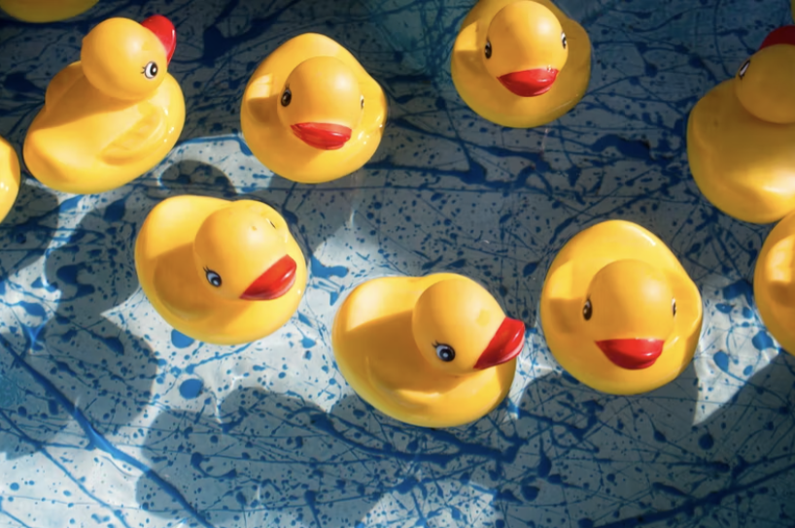
How do you find and conduct user research with this user group?
© This is Milk 2022
Notes:
Divider slide - Green
Copyright footer: © This is Milk 2020
Divider – Text – Yellow
Date format: 9-Jun-22
Font / Weight: Futura LT Book - Regular
Title font size: 32pt
Left Aligned

Slide 27
Find Neurodivergent and Disabled People
How?
Charities
Recruitment agencies
Your network
Clients
© This is Milk 2022
Notes:
Divider slide - Green
Copyright footer: © This is Milk 2020
Divider – Text – Yellow
Date format: 9-Jun-22
Font / Weight: Futura LT Book - Regular
Title font size: 32pt
Left Aligned

Slide 28
Find neurodivergent and disabled people
Charities e.g.
Action for M.E
British Dyslexia Association
Guide Dogs for the Blind Association
Leonard Cheshire
MND Association
Multiple Sclerosis Society
Parkinson's UK
Royal National Institute for the Blind
© This is Milk 2022
Notes:
Divider slide - Green
Copyright footer: © This is Milk 2020
Divider – Text – Yellow
Date format: 9-Jun-22
Font / Weight: Futura LT Book - Regular
Title font size: 32pt
Left Aligned

Slide 29
Find Neurodivergent and Disabled People
Ways to approach
Research some guidance
Check what terminology do they.
Know in advance if they need any adjustments for the research session.
Get informed consent for user research.
Provide instructions with the participants prior to the research session.
© This is Milk 2022
Notes:
Divider slide - Green
Copyright footer: © This is Milk 2020
Divider – Text – Yellow
Date format: 9-Jun-22
Font / Weight: Futura LT Book - Regular
Title font size: 32pt
Left Aligned

Slide 30

My Experience
© This is Milk 2022
Notes:
Divider slide - Green
Copyright footer: © This is Milk 2020
Divider – Text – Yellow
Date format: 9-Jun-22
Font / Weight: Futura LT Book - Regular
Title font size: 32pt
Left Aligned

Slide 31
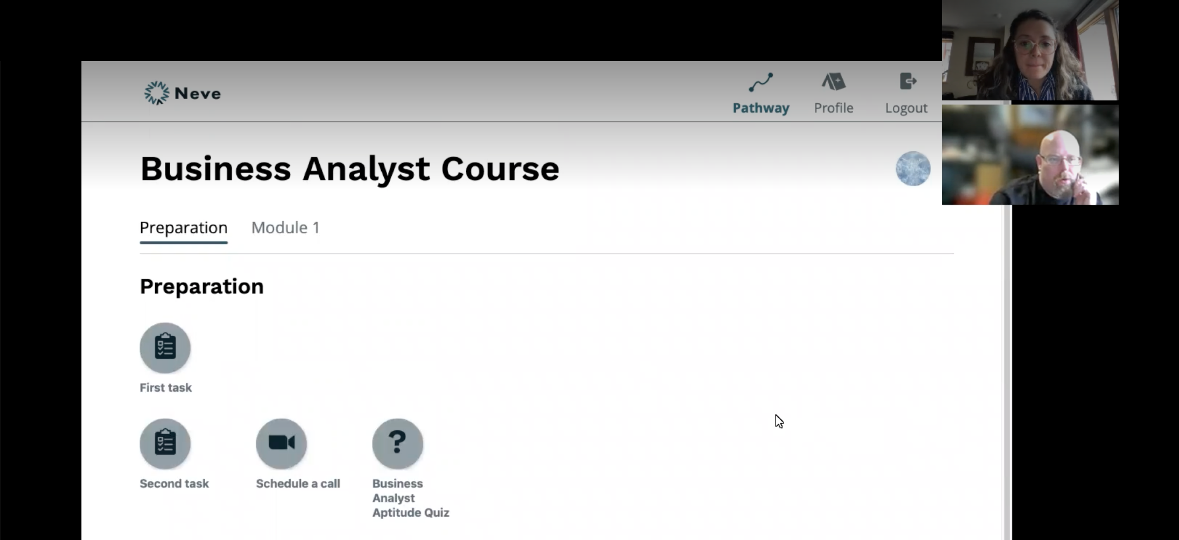


© This is Milk 2022
Notes:
Divider slide - Green
Copyright footer: © This is Milk 2020
Divider – Text – Yellow
Date format: 9-Jun-22
Font / Weight: Futura LT Book - Regular
Title font size: 32pt
Left Aligned

Slide 32
Prepare and Plan
Look at guidance and attend events.
Share clear instructions and expectations in advance.
Ask them if any needs or support was required during the interview.
Allow extra time for questions when planning the session.
Provide clear, bullet-pointed instructions, expectations, time commitment - both written and verbally.
Do one-to-one interviews.
Mute anything that can cause distraction before starting the interview.
© This is Milk 2022

Slide 33
Conduct User Research
Treat them like any participant.
Make them talk but don’t overwhelm.
Allow extra time.
Make sure they are comfortable.
Don’t rely on facial expressions.
Be patient and open-minded.
© This is Milk 2022

Slide 34
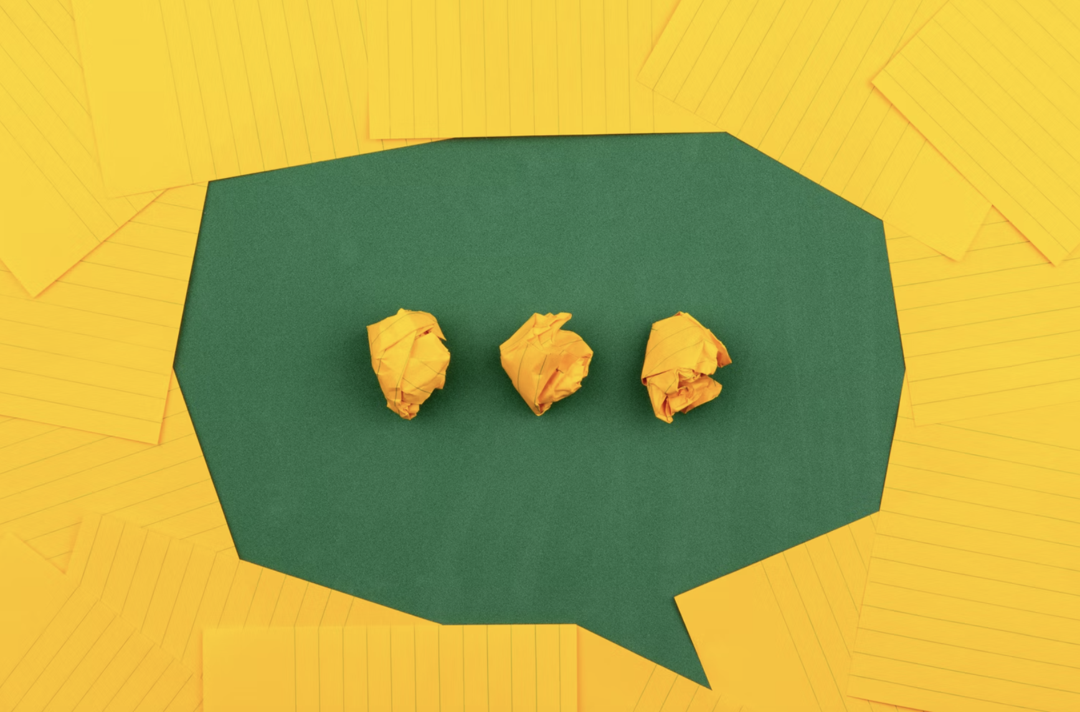
How do you communicate with neurodivergent and disabled people?
Notes:
Divider slide - Green
Copyright footer: © This is Milk 2020
Divider – Text – Yellow
Date format: 9-Jun-22
Font / Weight: Futura LT Book - Regular
Title font size: 32pt
Left Aligned

Slide 35
General Guidelines
Don’t say ‘suffering’ – be factual over value judgements.
Don’t refer to non-disabled people as ‘normal’.
Don’t lump together people in certain groups.
Avoid assumptions and stereotypes.
Check preferred language.
Inclusive language resources: Read words to use and avoid when writing about disability- GOV.UK (www.gov.uk)
inclusive-language-guidelines.pdf (cii.co.uk)

Slide 36
Ways to Approach
With an individual, you could say, ‘I’m mindful to use inclusive language around disabilities and neurodiversity and that there are various views on terms. Can I check your preferred terminology?’
With a group, you could say, ' I'm going to use the term ‘disabled people’ a charity as preferred term in line with social model of disability.’
Can invite people to correct you.

Slide 37

Notes:
Please don’t forget to complete the survey

